Slide 1

GITAM (Deemed to be university) School of Technology, Hyderabad Department of Computer Science and Engineering
Leveraging Predictivity of Deep Learning Techniques on Financial Time Series Forecasting
Project Batch No: P10-15
Name of Student(s) and Full Reg No(s):
Sri Vaishnavi Vasa - HU21CSEN0100673
Leena Deekollu - HU21CSEN0100741
Y. Bindu Sri - HU21CSEN0101184
Guide Name:
Prof. Sarat Chandra Nayak

Slide 2
CONTENTS
Introduction
Abstract
Review of literature Survey
Problem statement
Objectives
Requirement analysis/Dataset
Identification of Tools/Technologies
Design/Flowchart of complete project
References

Slide 3
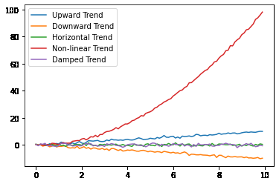
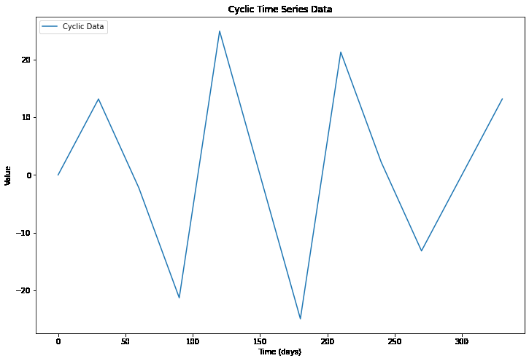
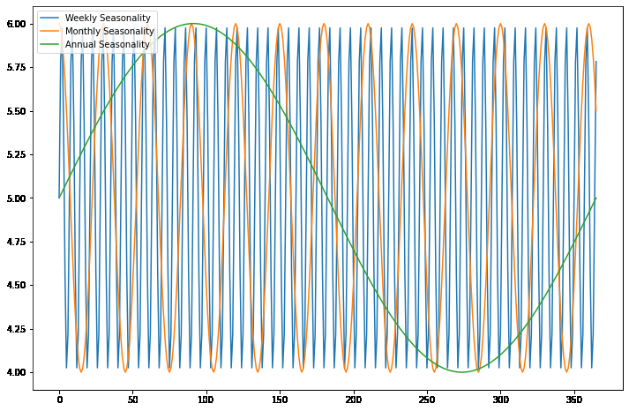
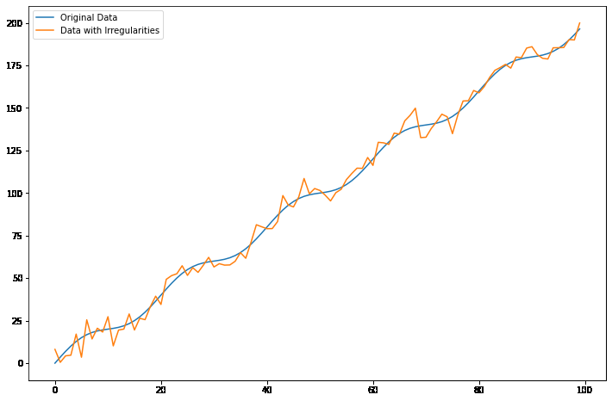
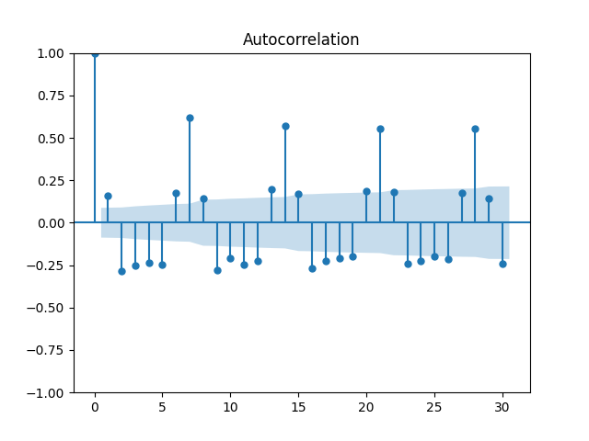
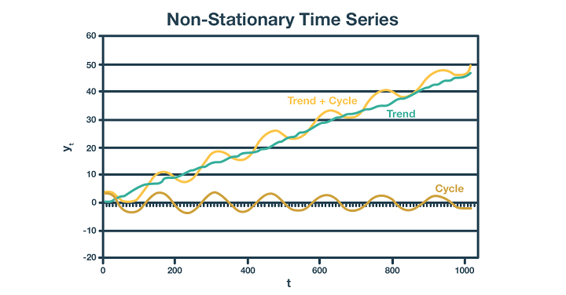
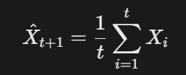
INTRODUCTION
Time Series Data
Time series data consists of observations recorded sequentially over time. Each data point corresponds to a specific time instance, such as daily stock prices, monthly sales data, or annual rainfall measurements.
Time series data exhibits key characteristics such as trend (long-term upward or downward movements), seasonality (repeating patterns over specific periods), cyclicity (irregular cycles without fixed periods), autocorrelation (relationship between values at different time lags), and irregularities (unexpected or random fluctuations like noise or outliers
Time Series Forecasting
Time series forecasting uses historical data to predict future values. For a time series X={X1,X2,X3,……,Xt}, where Xt is represents the observation at time t, the forecast for the next period (t+1) can be expressed as:
This simple method averages past observations, assuming the future will follow historical patterns. However, more complex models like ARIMA, LSTM, and CNNs are often used to account for trends, seasonality, and irregularities in the data.
TREND
SEASONALITY
CYCLICITY
IRREGULARITIES
AUTOCORRELATION
STATIONARITY
Fig : Characteristics of Time Series Data

Slide 4
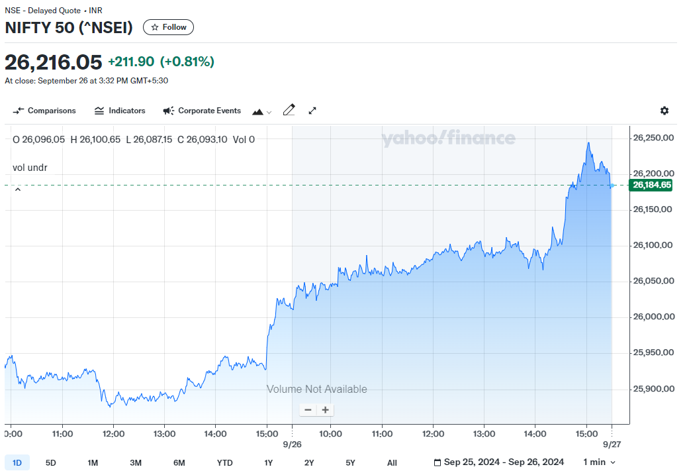
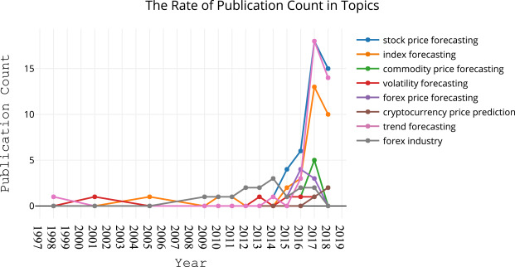
Financial Time Series
Financial time series refers to sequences of data related to financial metrics, such as stock prices, interest rates, or exchange rates, recorded at regular intervals. This data helps investors and analysts understand market behavior and predict future movements.
Financial Time Series Forecasting
Forecasting financial time series involves predicting future financial data points based on historical trends. This helps in investment strategies, risk assessment, and market trend analysis. Advanced models like RNNs, LSTMs, and hybrid systems address complexities like non-stationarity and volatility in financial data
Application Areas of Financial Time Series Forecasting
Stock Market Prediction: Forecasting stock prices and trends for informed investment decisions.
Foreign Exchange (Forex): Predicting currency exchange rates for global trading strategies.
Commodity Pricing: Anticipating price changes in commodities like oil and gold to manage risks.
Cryptocurrency Analysis: Analyzing trends in digital assets like Bitcoin and Ethereum.
Risk Management: Assessing credit risk and managing portfolio risks effectively.
Economic Policy Planning: Assisting governments and organizations in economic forecasting and planning.
Source: Yahoo finance - NIFTY 50 Chart
Fig : Images showing real-time financial time series forecasting example and research done in this field

Slide 5
ABSTRACT
Financial time series forecasting has become a vital focus within computational intelligence, engaging finance researchers in academia and industry alike due to its broad applications and substantial impact. While numerous Machine Learning (ML) models have been developed for this purpose, an extensive array of surveys already exists covering ML applications in financial forecasting.
More recently, Deep Learning (DL) models have entered the field, showing significant performance improvements over traditional ML methods. However, despite the growing interest in DL for financial time series forecasting, there is a notable lack of research focused specifically on DL applications for finance, particularly for region-specific data. This research aims to bridge this gap by experimenting with various DL models to optimize forecasting accuracy specifically for the Bombay Stock Exchange. Through this study, we seek not only to review current DL approaches but also to identify, improve, and potentially introduce a novel model tailored to Indian stock data. In addition to providing a comprehensive review, this research highlights potential setbacks and emerging opportunities in DL for financial forecasting, offering insights valuable to future researchers in the field.

Slide 6
REVIEW OF LITERATURE SURVEY
PUBLISHED YEAR | PUBLICATION DETAILS | TITLE | AUTHORS | MODEL PROPOSED | BASELINE MODELS | RESULTS | RESEARCH GAP | DATASET
[15/10/2024] | MDPI : Algorithms | ANovelApproach to Predict the Asian Exchange Stock Market Index Using Artificial Intelligence | Rohit Salgotra, Harmanjeet Singh and SzymonLukasik, Gurpreet Kaur, Supreet Singh, Pratap Singh | A hybrid deep learning model combining Bi-directional Gated Recurrent Unit (BGRU) with a Convolutional Neural Network (CNN) for predicting the closing prices of stock indices in six Asian stock markets | The study compares the proposed hybrid model against Convolutional RNN, Convolutional LSTM, Convolutional GRU, Convolutional Bi-directional RNN, Convolutional Bi-directional LSTM, and Convolutional Bi-directional GRU | The proposed hybrid model achieved the lowest Root Mean Squared Error (RMSE) and highest accuracy, outperforming the baseline models in predicting stock index values. The hybrid model produced an RMSE of 0.0122 and a Mean Absolute Percentage Error (MAPE) of 1.31% on the BSE index​ | The paper highlights the need for a hybrid model that can improve prediction accuracy by accounting for multivariable input and handling chaotic stock market data, which traditional models fail to address effectively | Time-series data from six Asian stock exchanges (BSE, HSI, TWII, JPXGY, JKSE, and KS11) between April 2020 and March 2024, containing features such as open price, close price, high price, low price, adjusted close price, and volume​
Full table can be accessed through this link: https://tinyurl.com/research-table

Slide 7
PUBLISHED YEAR | PUBLICATION DETAILS | TITLE | AUTHORS | MODEL PROPOSED | BASELINE MODELS | RESULTS | RESEARCH GAP | DATASET
[15/10/2024] | SSRN | Large Language Models for Financial Time Series Forecasting | Miguel Noguer i Alonso, Rodolfo Pereira Franklin (Artificial Intelligence Finance Institute) | The paper explores the use of Large Language Models (LLMs) for time series forecasting, focusing on a new model, Time-LLM, which reprograms time series data into textual prototypes to leverage LLM capabilities for forecasting | Several models were tested for comparison, including TimeGPT, NBEATS, NHITS, PatchTST, and KAN | The proposed Time-LLM and other models were evaluated using Mean Absolute Error (MAE), Mean Squared Error (MSE), and Root Mean Squared Error (RMSE). TimeGPT and TimeGPT Long Horizon models performed well in stable environments, while specialized models like KAN and PatchTST excelled in handling complex data | The study identifies a gap in adapting LLMs to handle time series data, particularly due to the continuous nature of such data, as LLMs typically work with discrete tokens | The dataset includes stock prices from companies like Google, Apple, Amazon, JPMorgan, and Meta from September 15, 2014, to September 12, 2024, sourced from Yahoo Finance​
Full table can be accessed through this link: https://tinyurl.com/research-table

Slide 8
PUBLISHED YEAR | PUBLICATION DETAILS | TITLE | AUTHORS | MODEL PROPOSED | BASELINE MODELS | RESULTS | RESEARCH GAP | DATASET
[26/09/2024] | arXiv: Computational Finance (q-fin.CP); Machine Learning (cs.LG) [arXiv:2410.03707 [q-fin.CP]] | Mamba Meets Financial Markets: A Graph-Mamba Approach for Stock Price Prediction | Ali Mehrabian, Ehsan Hoseinzade, Mahdi Mazloum, Xiaohong Chen | (SAMBA) The proposed model is SAMBA, a framework for stock price prediction. It integrates Bidirectional Mamba (BI-Mamba) for capturing long-term dependencies and Adaptive Graph Convolutional (AGC) for modeling interactions between daily stock features, significantly improving prediction accuracy and computational efficiency​ | The paper compares SAMBA to several models, including LSTM, Transformer, StockMixer, AGCRN, FourierGNN, and MambaStock. Each baseline has varying degrees of success in prediction tasks | SAMBA outperforms all the baseline models in RMSE, Information Coefficient (IC), and Rank Information Coefficient (RIC). For example, SAMBA achieves improvements in RMSE by 11.72% (NASDAQ), 10.07% (NYSE), and 6.90% (DJIA). It also reduces training time and memory requirements compared to some models, making it suitable for real-time trading | he research addresses the limitations of transformer-based models, such as high computational complexity and memory usage, by proposing a model that captures long-term dependencies efficiently through BI-Mamba and interactions between stock features via AGC. SAMBA addresses these limitations with its near-linear time complexity and the ability to capture both temporal and relational dependencies | The model was trained and tested on three real-world stock market datasets: NASDAQ, New York Stock Exchange (NYSE), and Dow Jones Industrial Average (DJIA), covering the period from January 2010 to November 2023
Full table can be accessed through this link: https://tinyurl.com/research-table

Slide 9
PUBLISHED YEAR | PUBLICATION DETAILS | TITLE | AUTHORS | MODEL PROPOSED | BASELINE MODELS | RESULTS | RESEARCH GAP | DATASET
[19/09/2024] | Elsevier: Scientific African | Stock price prediction using combined GARCH-AI models | John Kamwele Mutinda, Amos Kipkorir Langat | The paper proposes GARCH-AI hybrid models, integrating GARCH with advanced AI models like LSTM, GRU, and Transformer. These models combine statistical properties of volatility (captured by GARCH) with long-term dependencies in time series (handled by AI models) for stock price prediction | Standalone models like LSTM, GRU, and Transformer are used as baselines to compare the performance of hybrid models | The hybrid models, particularly GARCH-LSTM, outperform the standalone models, achieving the best performance with the lowest RMSE, MAE, and MAPE, and the highest R-squared values​ | The paper identifies a lack of research on combining GARCH with AI models, especially in direct stock price forecasting, as most previous studies focus on volatility prediction. It aims to fill this gap by developing and testing hybrid models | The dataset consists of Airtel stock data from June 28, 2019, to May 8, 2024, including daily trading information such as open, high, low, close, adjusted close, and volume
Full table can be accessed through this link: https://tinyurl.com/research-table

Slide 10
1. Comprehensive Review of Deep Learning Models (2005–2019):
Objective: This review categorizes 200 studies on financial time series forecasting, covering indices, forex, and commodities.
Models: CNNs, LSTMs, DBNs, and other deep learning architectures.
Findings: Deep learning models significantly outperform traditional ML models in capturing complex patterns.
Challenges: Limited review papers focus exclusively on DL for financial forecasting, with gaps in model interpretability and real-world applications.
Datasets: Examples include S&P 500 and Chinese stock markets.
2. Advancements in Deep Learning (2020–2022):
Focus: Recent studies explore models like Transformers, GANs, Graph Neural Networks (GNNs), and Deep Quantum Neural Networks (DQNNs).
Findings: Transformers and GANs show promise for price forecasting but require larger datasets and improved hardware/software.
Challenges: Insufficient interval predictions and lack of standardized benchmarks.
Future Directions: Expand interval forecasting, validate decomposition models, and optimize Transformer models for financial applications.
3. Machine Learning and Deep Learning Applications (2023):
Scope: This review examines the integration of ML and DL in various financial domains, including stock markets, portfolio management, and cryptocurrency.
Findings: Enhanced forecasting accuracy and scalability through advanced models like hybrid architectures.
Challenges: Issues with data quality, overfitting, and generalization persist.
Opportunities: Improved sentiment analysis, feature selection methods, and reinforcement learning for financial applications.
Overall, the reviews highlight the growing importance of deep learning in financial forecasting, emphasizing its potential to outperform traditional methods while addressing challenges like model complexity and computational costs

Slide 11
LITERATURE SUMMARY
Recent advancements in financial time series forecasting leverage deep learning and hybrid models to address challenges in accuracy and efficiency:
Hybrid Models:
Combining Bi-GRU and CNN models has significantly improved prediction accuracy for chaotic stock market data (e.g., Asian stock exchanges)​.
Hybrid GARCH-AI models integrate statistical properties with deep learning (LSTM, GRU) to enhance volatility and price prediction.
Innovative Architectures:
SAMBA, a Graph-Mamba model, captures long-term dependencies and stock feature interactions efficiently using Adaptive Graph Convolutions​.
Time-LLM employs transformers, adapting financial time series data into textual prototypes for superior forecasting​.
Challenges Addressed:
Non-linearity, volatility, and computational complexities in traditional models are effectively managed.
Larger datasets, better interval predictions, and hardware optimizations remain areas for improvement.
These advancements highlight the growing potential of deep learning and hybrid systems in financial forecasting while addressing critical limitations of traditional methods.
Full table can be accessed through this link: https://tinyurl.com/research-table

Slide 12
PROBLEM STATEMENT
Financial time series forecasting faces significant challenges that can compromise the accuracy and reliability of predictions. Issues such as data quality, including missing values and gaps in historical records, pose considerable hurdles for forecasting models. Additionally, nonstationarity in financial data, often caused by structural breaks from market regulations or global events, complicates the modeling process. The inherent volatility and uncertainty of financial markets further necessitate advanced modeling techniques capable of capturing the complex, nonlinear relationships among variables, as traditional linear models may not adequately reflect the dynamics of these systems.
Despite the increasing interest in deep learning (DL) techniques, there is a notable lack of comprehensive literature reviews focusing on their implementation and effectiveness in financial time series forecasting. This research aims to fill this gap by systematically reviewing existing DL methodologies, highlighting their strengths and weaknesses, and evaluating their predictability in overcoming common challenges such as overfitting and model generalization. Furthermore, we will experiment with various DL models on financial datasets, specifically focusing on the Bombay Stock Exchange, to identify an optimized model for this context. By leveraging the predictive capabilities of DL, this study seeks to enhance forecasting accuracy, ultimately contributing to improved decision-making processes within the finance industry.

Slide 13
OBJECTIVES
Enhance Forecasting Accuracy: To develop and optimize deep learning models for financial time series forecasting, focusing on improving prediction accuracy for the Bombay Stock Exchange.
Review and Analyze Existing DL Models: To systematically review current deep learning methodologies used in financial forecasting, highlighting their strengths, limitations, and potential for improvement.
Address Key Challenges: To tackle common forecasting issues, such as non-stationarity, missing data, and market volatility, by leveraging advanced deep learning techniques.
Experiment with Region-Specific Data: To tailor forecasting models specifically for Indian financial markets, utilizing datasets from the Bombay Stock Exchange to capture region-specific patterns.

Slide 14
Introduce Hybrid Approaches:
To explore hybrid models that integrate deep learning with traditional statistical methods for enhanced feature extraction and forecasting.
Incorporate External Factors:
To enhance model performance by integrating external data, such as economic indicators, news sentiment, and social media trends.
Promote Explainability:
To develop explainable AI models that offer insights into the decision-making process and feature importance, ensuring transparency and trust.
Explore Real-Time Applications:
To create adaptable models capable of online learning and low-latency inference for real-time financial forecasting and decision-making.
Contribute to Ethical AI Practices:
To address fairness, bias, and responsible AI deployment in financial systems, ensuring equitable and ethical predictions.
Evaluate and Compare Models: To experiment with and compare various deep learning models (e.g., LSTM, GRU, Transformers) to identify the most effective model for the given context.

Slide 15
DATASET
Selected Dataset : BSE (Bombay Stock Exchange) SENSEX Next 50
The BSE SENSEX Next 50 TMC is designed to measure the performance of the 50 largest and most liquid companies within the BSE 500 that are not members of the BSE SENSEX 50 TMC.
Long Historical Data: Established in 1875, BSE offers extensive historical data, beneficial for identifying long-term trends and cycles.
Diverse Company Listings: Includes a broad range of industries, especially small and mid-cap companies, providing a more comprehensive view of the Indian economy.
Broader Market Representation: BSE’s SENSEX index reflects general market sentiment and serves as an economic barometer.
Greater Volatility: The inclusion of smaller stocks introduces more volatility, useful for forecasting market sentiment and risk.
Unique Insights from Trading Volumes: BSE’s data includes lower-volume trades, helping model less-liquid asset behavior.
Event Sensitivity: BSE data reflects responses to major events like COVID-19, financial scams, and policy shifts, providing insight into how markets react to crises.

Slide 16
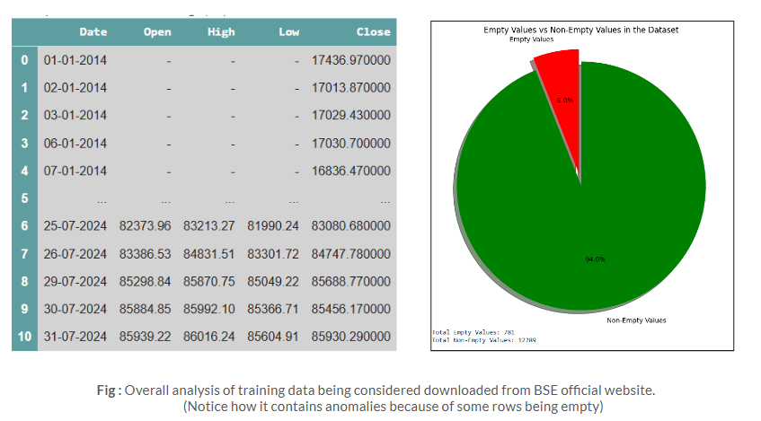
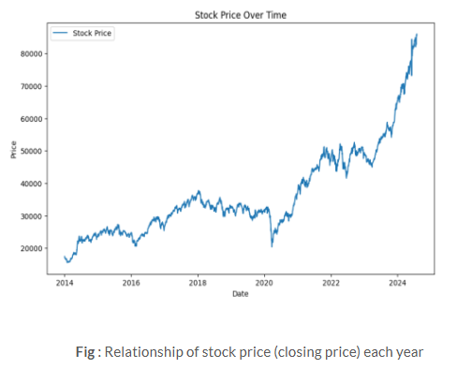
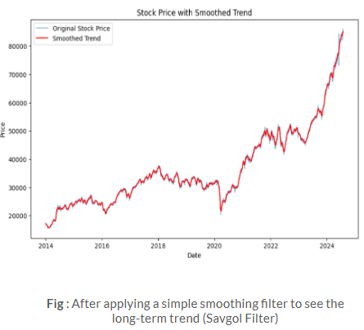
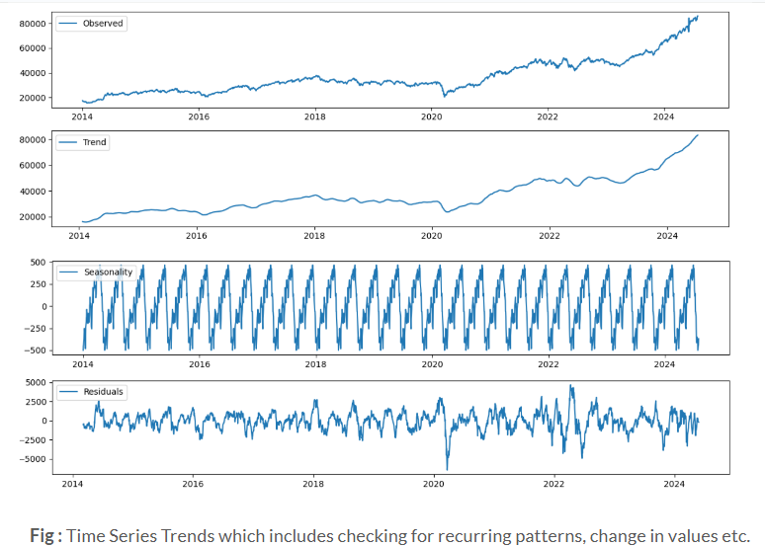
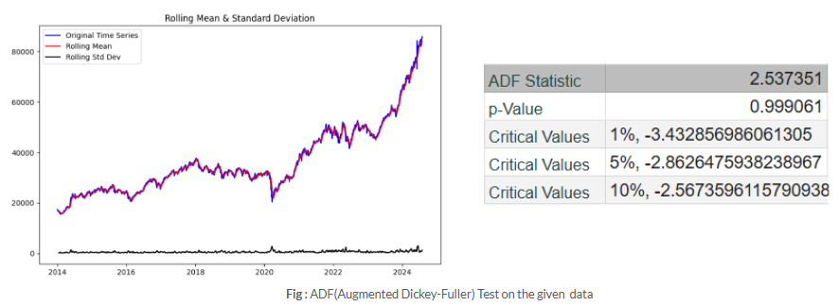
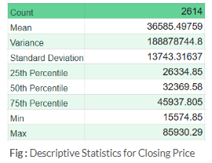

Slide 17
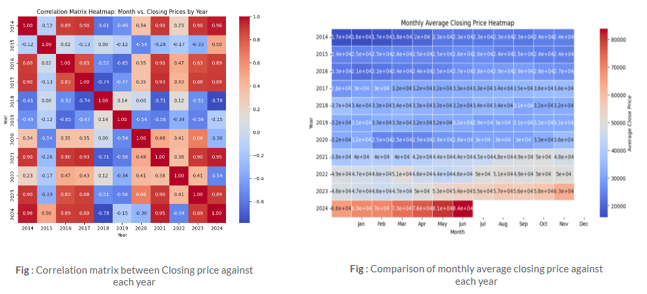
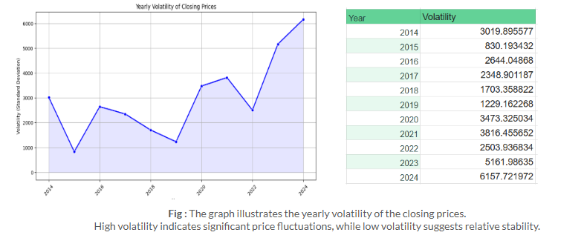

Slide 18






IDENTIFICATION OF TOOLS/TECHNOLOGIES
Regression Test Parameters
MAE: Average absolute error between predicted and actual values; lower is better.
MSE: Average squared error, penalizing larger deviations; useful for reducing large errors.
RMSE: Square root of MSE, providing error in the same unit as the target variable.
MAPE: Average percentage error, scale-independent; lower values indicate higher accuracy.
Binary Classifier Metrics
Accuracy: Percentage of correct predictions; suitable for balanced datasets.
Precision: True positives among predicted positives; minimizes false positives.
Recall (Sensitivity): True positives among actual positives; minimizes false negatives.
F1 Score: Harmonic mean of precision and recall; balances both metrics for uneven classes.
ROC-AUC: Measures model's ability to distinguish classes; higher values reflect better performance.
Fig: Implementation Tools

Slide 19
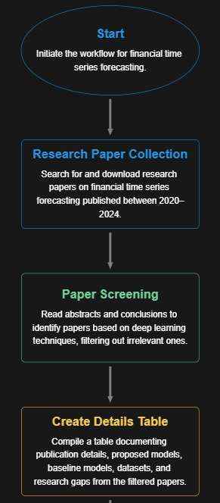
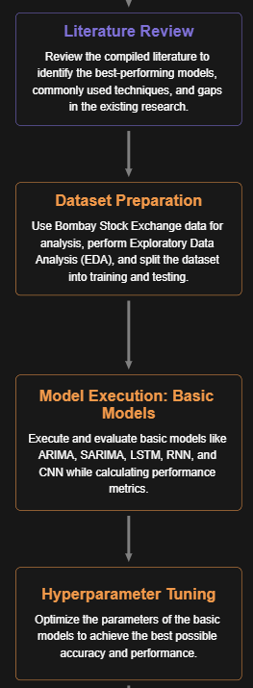
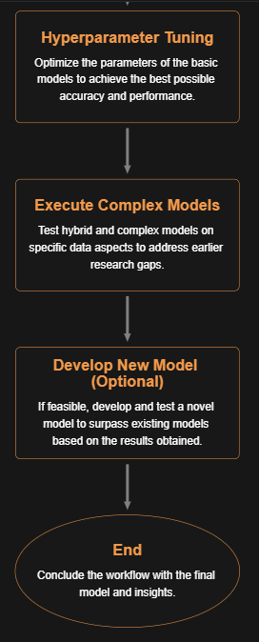
DESIGN/FLOWCHART OF COMPLETE PROJECT

Slide 20
REFERENCES
Rohit Salgotra, Harmanjeet Singh, Szymon Lukasik, Gurpreet Kaur, Supreet Singh, Pratap Singh. (2024). "A hybrid deep learning model combining Bi-directional Gated Recurrent Unit (BGRU) with a Convolutional Neural Network (CNN) for predicting the closing prices of stock indices in six Asian stock markets." MDPI: Algorithms​.
Miguel Noguer i Alonso, Rodolfo Pereira Franklin. (2024). "Large Language Models for Financial Time Series Forecasting." SSRN.
Ali Mehrabian, Ehsan Hoseinzade, Mahdi Mazloum, Xiaohong Chen. (2024). "Mamba Meets Financial Markets: A Graph-Mamba Approach for Stock Price Prediction." arXiv: Computational Finance​.
John Kamwele Mutinda, Amos Kipkorir Langat. (2024). "Stock price prediction using combined GARCH-AI models." Elsevier: Scientific African.
ADDITIONAL LINKS:
Review 1 Presentation - https://docs.google.com/presentation/d/1KwmnbbVUuaTFaNHmZv5oxk0jVUT_Ps3IoYTtMxvSTNc/edit?usp=sharing
Review 2 Presentation - https://docs.google.com/presentation/d/1cO7-S2yZh2ff25W0rJEPEmpSjrXXucY-QegiwBwBmHo/edit?usp=sharing
Research Papers Table - https://docs.google.com/spreadsheets/d/1SftDQfazZgzaxWYPDXQE2Cem6kQNTYJnk8-RBBf0azI/edit?usp=sharing

Slide 21

THANK YOU

